Slide 1
Q-learning Vs. SARSA applied to SMART CAB
A PROJECT PRESENTATION
Submitted by
MOHAMMAD WASIL SALEEM
MATRIKEL Nr.: 805779
[MAT-DSAM3A] Advanced Data Assimilation and Modeling A
Reinforcement Learning

Slide 2
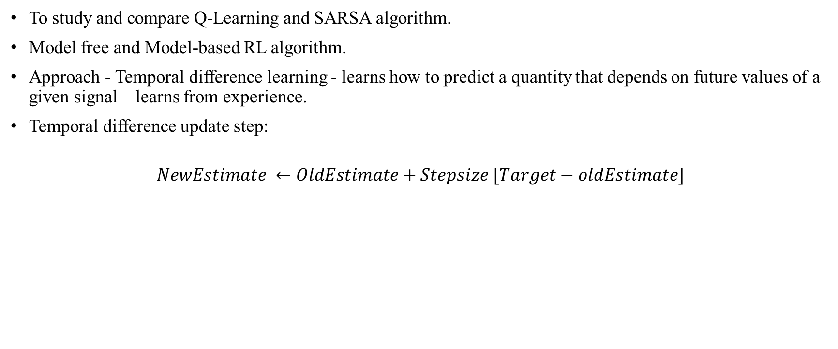
MOTIVATION
To study and compare Q-Learning and SARSA algorithm.
Model free and Model-based RL algorithm.
Approach - Temporal difference learning - learns how to predict a quantity that depends on future values of a given signal – learns from experience.
Temporal difference update step:
$$NewEstimate ←OldEstimate+Stepsize [Target−oldEstimate]$$

Slide 3
SMART CAB GAME
Inspired from OpenAI gym environment.
2D grid 5x5 cells.
Agent - Cab
Drop off and pick up locations.
Objective of the game:
pick up the passenger.
drop off the passenger at the right location.
take as minimum time as possible.
Coordinate System: See Screenshot.
Pickup positions: [0, 0], [0, 4], [4, 0] and [4, 3].
Dropoff positions: [0, 0], [0, 4], [4, 0] and [4, 3].
Rules:
Drop off location should not be equal to Pickup location in one episode.
Cab cannot go through the walls.
Cab can move “UP”, “DOWN”, “LEFT”, and “RIGHT. No Diagonal movements.
Cannot go beyond the extreme rows and columns.

Slide 4
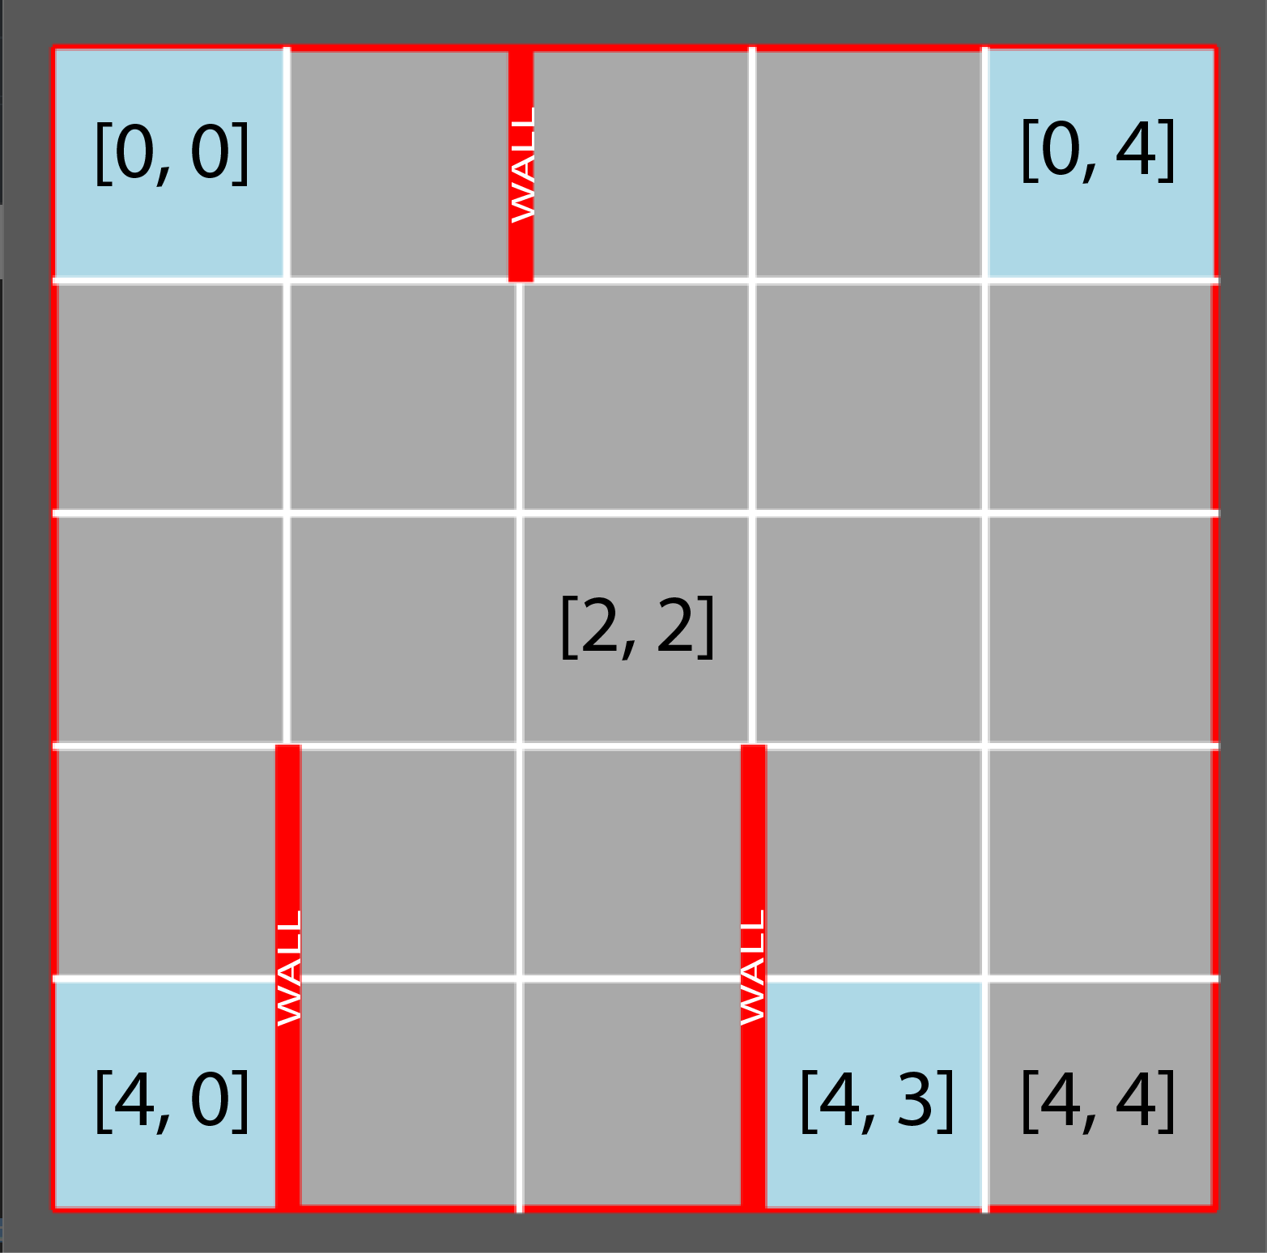
GRID

Slide 5
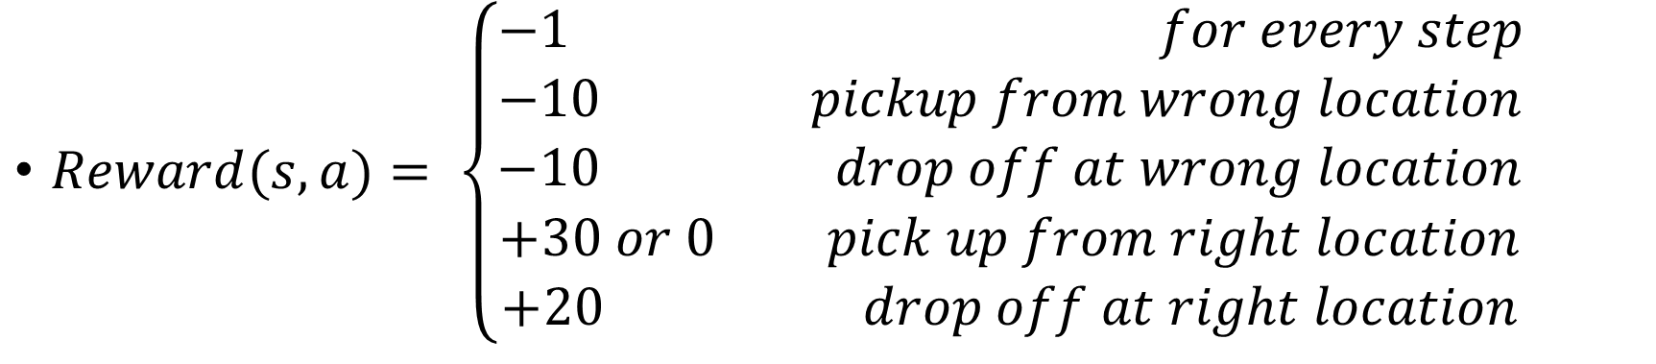
REWARD FUNCTION
$Reward(s, a)= \left\{\begin{aligned}−1 for every step \\ −10 pickup from wrong location \\ −10 drop off at wrong location \\ +30 or 0 pick up from right location \\ +20 drop off at right location\end{aligned}\right.$

Slide 6
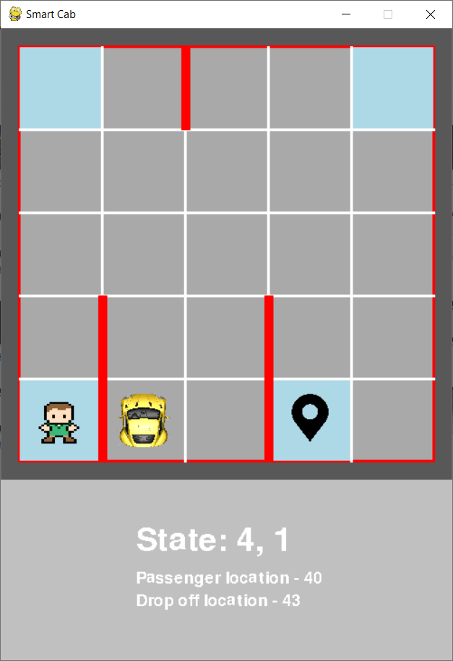
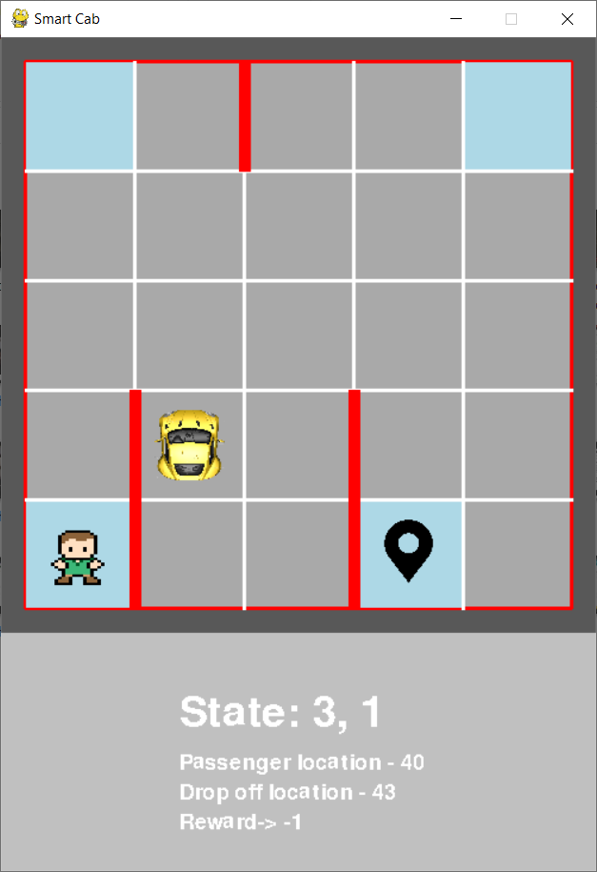
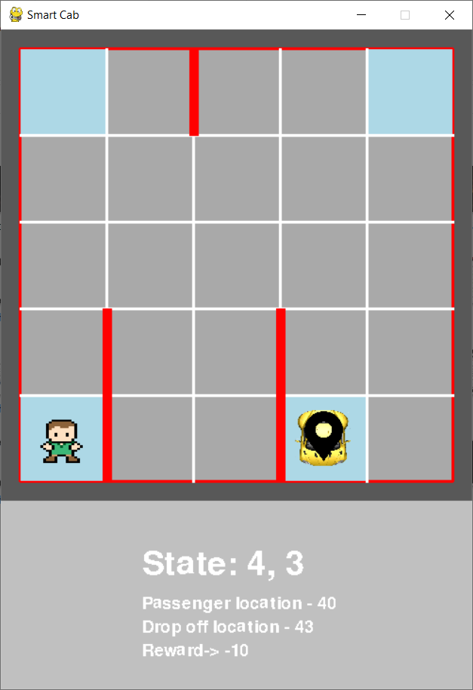
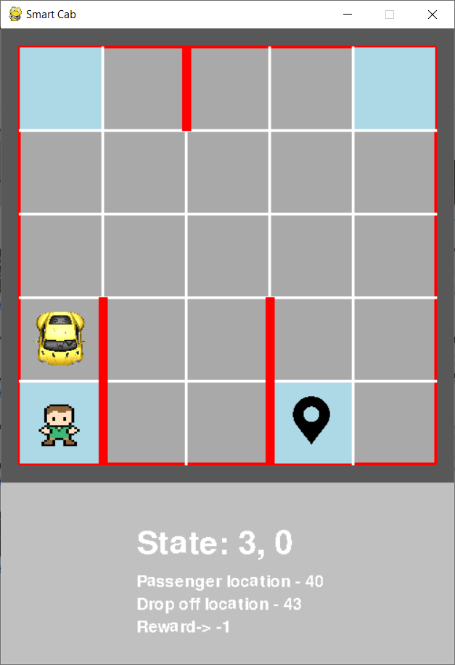
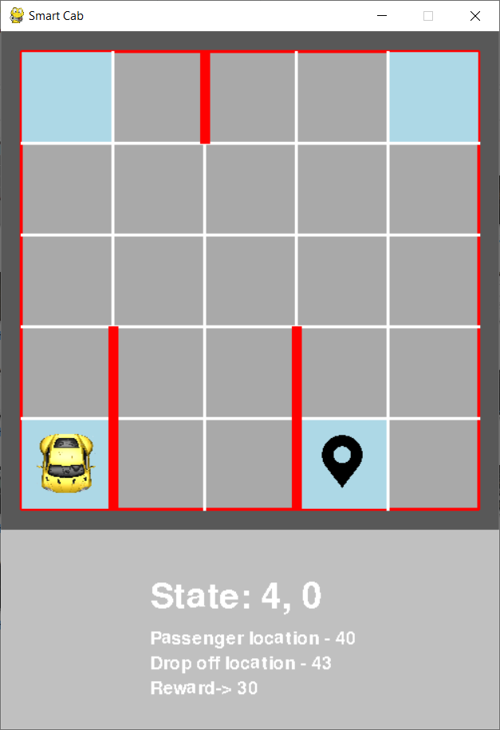
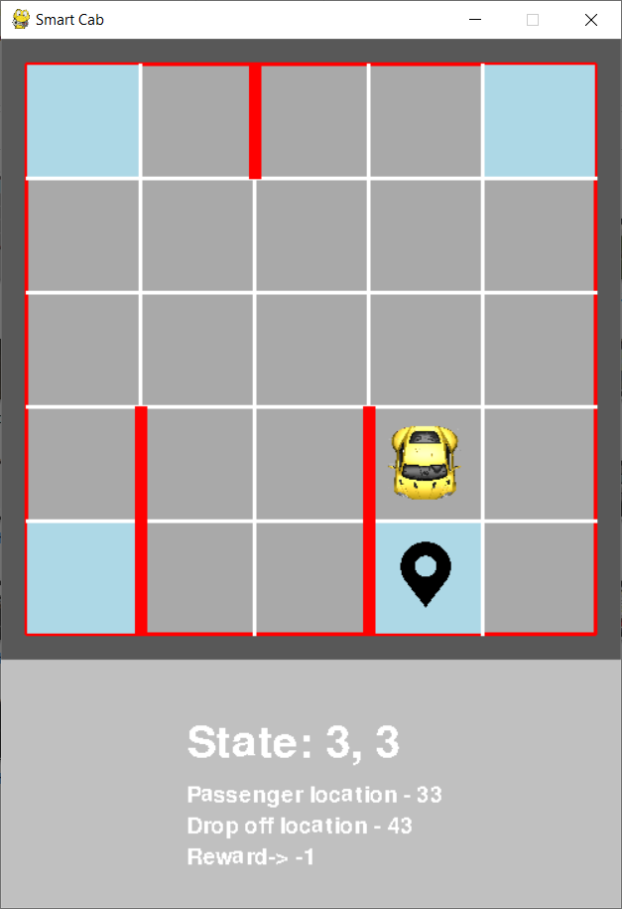
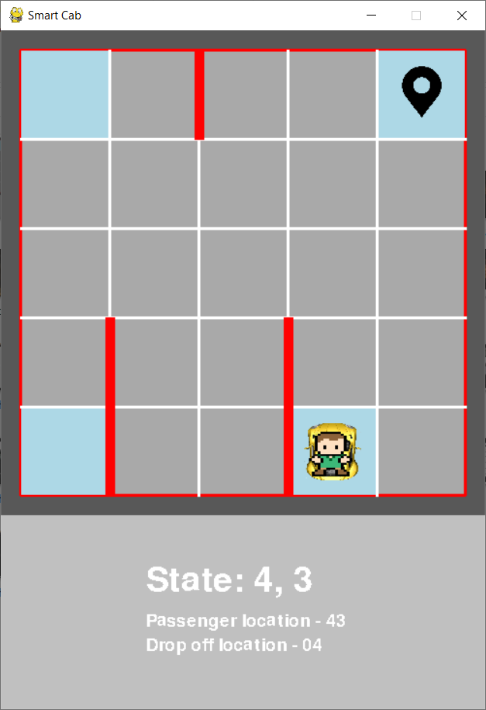
Game work flow…

Slide 7
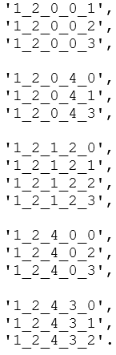
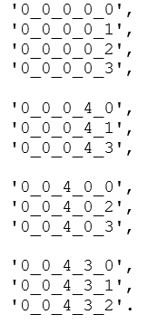
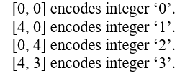
STATE SPACES
Total number of States = 52 + 336 = 388
21x16 = 336 States
13x4 = 52 States

Slide 8
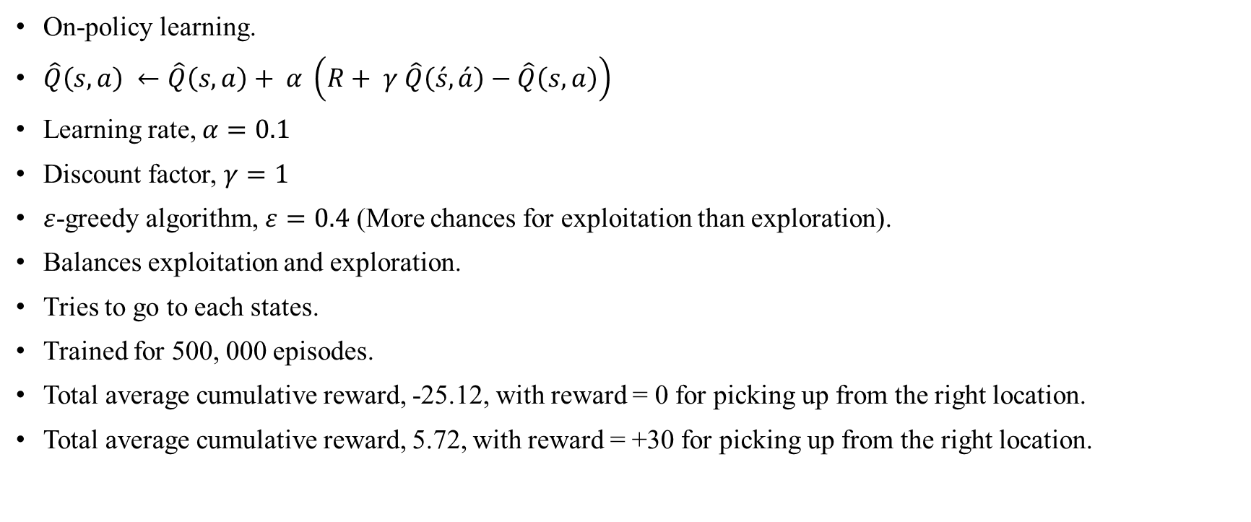
SARSA
On-policy learning.
$\hat{Q}\left(s, a\right) ←\hat{Q}\left(s, a\right)+ α \left(R+ γ \hat{Q}\left(\acute{s}, \acute{a}\right)−\hat{Q}\left(s, a\right)\right)$
Learning rate, $α=0.1$
Discount factor, $γ=1$
$ε$-greedy algorithm, $ε=0.4$ (More chances for exploitation than exploration).
Balances exploitation and exploration.
Tries to go to each states.
Trained for 500, 000 episodes.
Total average cumulative reward, -25.12, with reward = 0 for picking up from the right location.
Total average cumulative reward, 5.72, with reward = +30 for picking up from the right location.

Slide 9
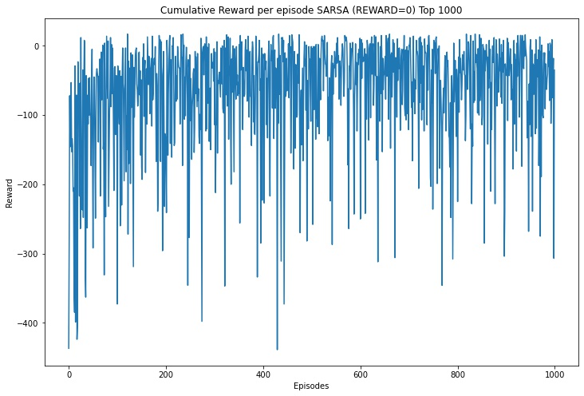
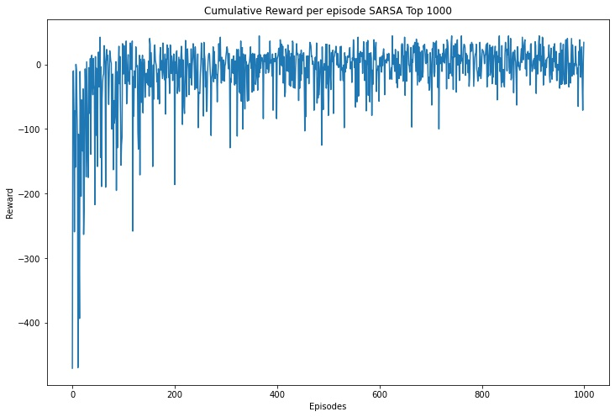

Slide 10
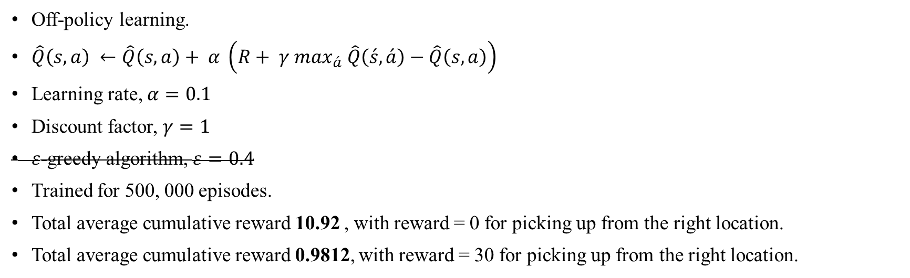
Q-LEARNING
Off-policy learning.
$\hat{Q}\left(s, a\right) ←\hat{Q}\left(s, a\right)+ α \left(R+ γ \max_{\acute{a}} \hat{Q}\left(\acute{s}, \acute{a}\right)−\hat{Q}\left(s, a\right)\right)$
Learning rate, $α=0.1$
Discount factor, $γ=1$
$ε$-greedy algorithm, $ε=0.4$
Trained for 500, 000 episodes.
Total average cumulative reward 10.92 , with reward = 0 for picking up from the right location.
Total average cumulative reward 0.9812, with reward = 30 for picking up from the right location.

Slide 11
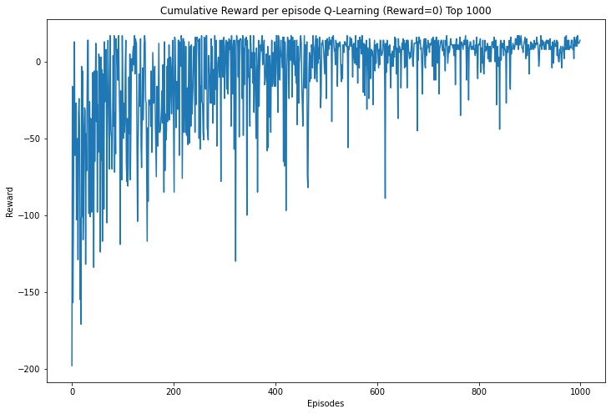
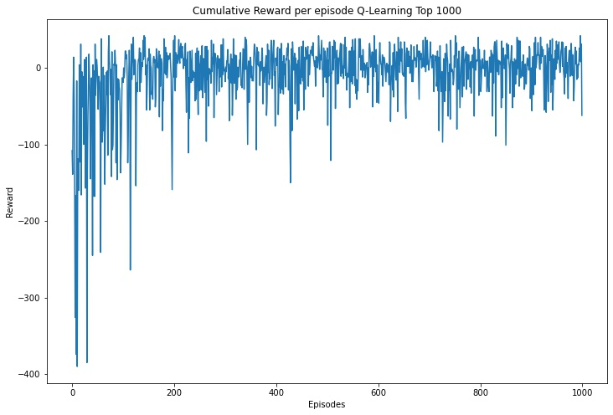

Slide 12
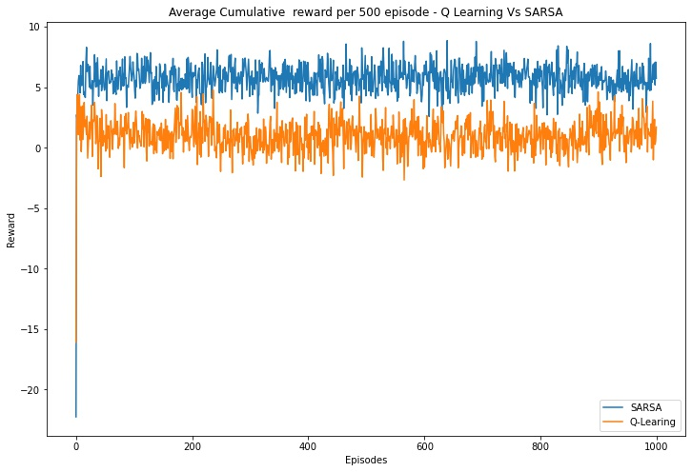
SARSA Vs. Q-LEARNING

Slide 13
CONCLUSION
Both are excellent approach for RL problems.
Q-Learning learns optimal policy.
SARSA learns “near” optimal policy.

Slide 14
REFERENCES
https://www.101computing.net/getting-started-with-pygame/
http://www.pygame.org/wiki/RotateCenter?parent=CookBook
https://gym.openai.com/envs/Taxi-v2/
https://www.learndatasci.com/tutorials/reinforcement-q-learning-scratch-python-openai-gym/
https://github.com/openai/gym/blob/master/gym/envs/toy_text/taxi.py
aakash94.github.io/Reward-Based-Epsilon-Decay/
https://stackoverflow.com/questions/53198503/epsilon-and-learning-rate-decay-in-epsilon-greedy-q-learning
https://wiki.pathmind.com/deep-reinforcement-learning
https://en.wikipedia.org/wiki/Model-free_(reinforcement_learning)
https://towardsdatascience.com/reinforcement-learning-temporal-difference-sarsa-q-learning-expected-sarsa-on-python-9fecfda7467e
https://medium.com/@violante.andre/simple-reinforcement-learning-temporal-difference-learning-e883ea0d65b0
https://towardsdatascience.com/reinforcement-learning-temporal-difference-sarsa-q-learning-expected-sarsa-on-python-9fecfda7467e
https://stats.stackexchange.com/questions/184657/what-is-the-difference-between-off-policy-and-on-policy-learning/376830#376830?newreg=703c24a8ebae4e75873f87dbd271717f
https://www.geeksforgeeks.org/epsilon-greedy-algorithm-in-reinforcement-learning/
https://www.cse.unsw.edu.au/~cs9417ml/RL1/algorithms.html
https://towardsdatascience.com/intro-to-reinforcement-learning-temporal-difference-learning-sarsa-vs-q-learning-8b4184bb4978
https://datascience.stackexchange.com/questions/9832/what-is-the-q-function-and-what-is-the-v-function-in-reinforcement-learning#:~:text=Q%CF%80(s%2Ca)%20is%20the%20action%2Dvalue,policy%20%CF%80%2C%20taking%20action%20a.

Slide 15
THANK YOU!

